Slide 1
Adversarial Attack on Text Classification
2021.02.24
심아름

Slide 2
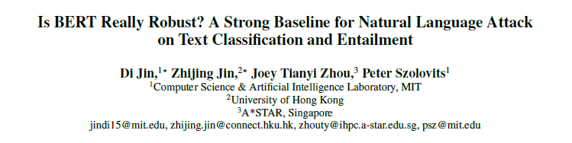
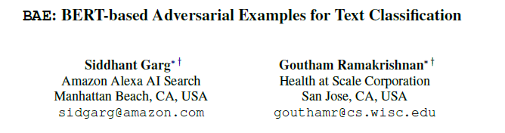
Papers
Notes:
AAAI 2020
EMNLP 2020

Slide 3
Text Classification
영화 리뷰 → 긍정 / 부정
뉴스 기사 카테고리 → 정치 / 과학 / 스포츠 / 연예
가짜 뉴스 분류 → T / F
메일 스팸 분류 → T / F
Text Entailment
두 문장(premise, hypothesis)을 입력 받아 두 문장 사이에 관계를 정의
Entailment : premise가 hypothesis를 포함
Contradiction : premise가 hypothesis와 모순
Neutral : 그 외, 관련 없음
(ex) P : 저는, 그냥 알아내려고 거기 있었어요
H: 이해하려고 노력하고 있었어요. → Entailment
H: 나는 처음부터 그것을 잘 이해했다. → Contradiction
H: 나는 돈이 어디로 갔는지 이해하려고 했어요. → Neutral

Slide 4
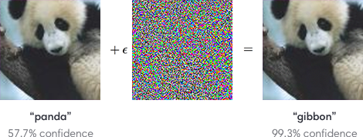
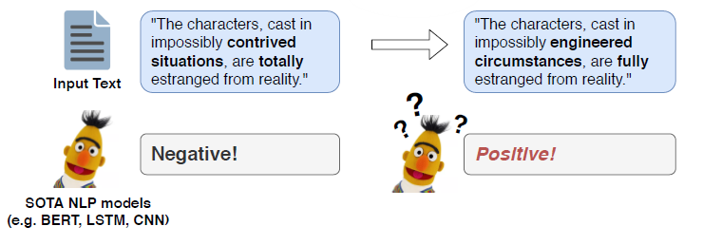
Text Adversarial Attack
Image
픽셀의 값들이 연속적
노이즈가 사람 눈에 잘 안 띔
Text
단어, 글자가 불연속적
약간의 변화도 사람 눈에 잘 띔
The characters, cast in impossibly contrived situations, are totally estranged from reality.
→ The characters, cast in impossibly engineered circumstances, are fully estranged from reality.

Slide 5
Text Adversarial Attack
Human prediction consistency
prediction by humans should remain unchanged
Semantic similarity
the crafted example should bear the same meaning as the source, as judged by humans
Language fluency
- generated examples should look natural and grammatical

Slide 6
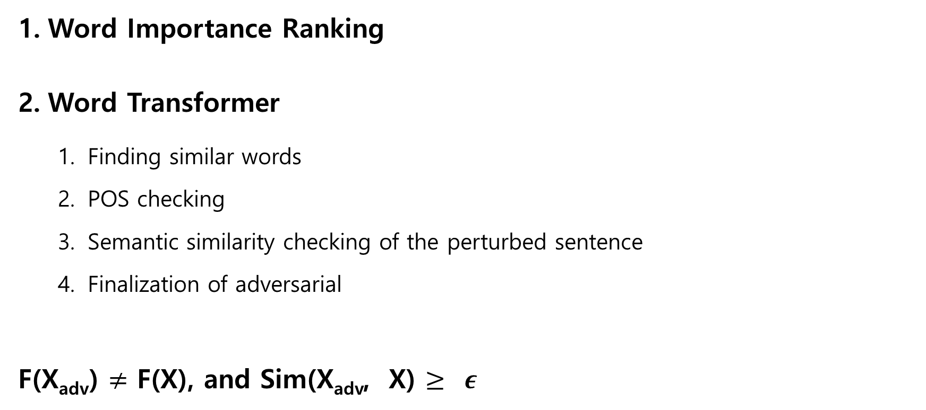
TEXTFOOLER
Word Importance Ranking
Word Transformer
Finding similar words
POS checking
Semantic similarity checking of the perturbed sentence
Finalization of adversarial
F(X_{adv}) $≠$ F(X), and Sim(X_{adv}, X) $≥ ε$
Notes:
Word Importance Ranking
Word Transformer
Synonym extraction : Finding similar words.
POS checking : Keeping the words with the same part-of-speech(POS)
Semantic similarity checking : Preserving semantic meaning of the perturbed sentence
Finalization of adversarial examples : Finding any candidate can alter the prediction

Slide 7
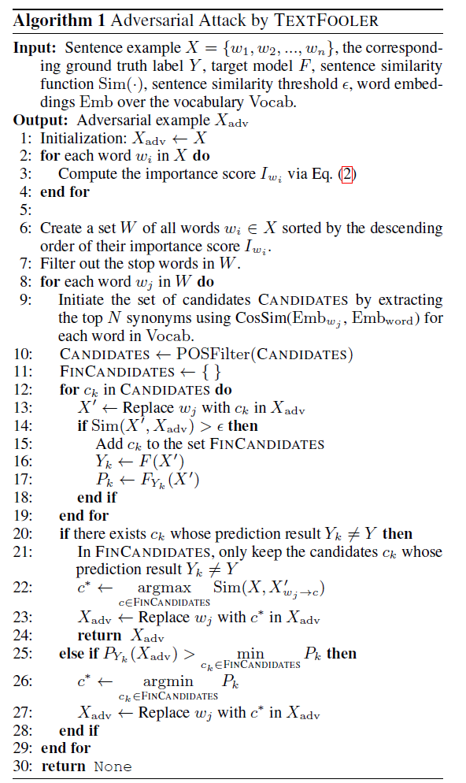
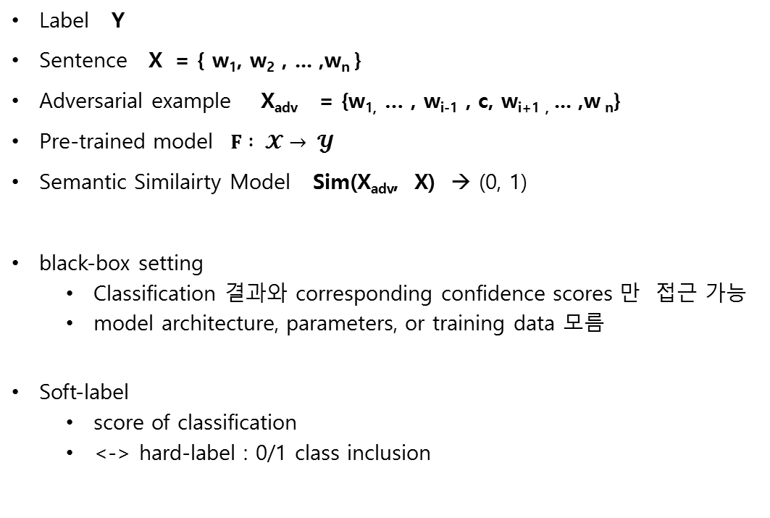
TEXTFOOLER
Label Y
Sentence X = { w₁, w₂ , ... ,w_{n} }
Adversarial example X_{adv} = {w_{1,} … , w_{i-1} , c, w_{i+1 ,} ... ,w _{n}}
Pre-trained model $F : 𝓧→ 𝓨$
Semantic Similairty Model Sim(X_{adv}, X) → (0, 1)
black-box setting
Classification 결과와 corresponding confidence scores 만 접근 가능
model architecture, parameters, or training data 모름
Soft-label
score of classification
<-> hard-label : 0/1 class inclusion
Notes:
F(X_{adv}) $≠$ F(X), and Sim(X_{adv}, X) $≥ ε$

Slide 8
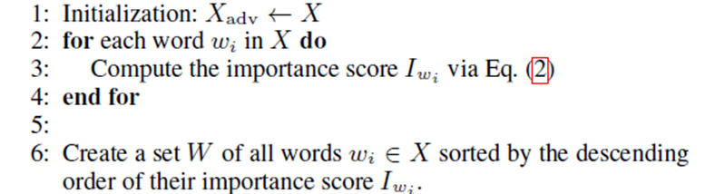
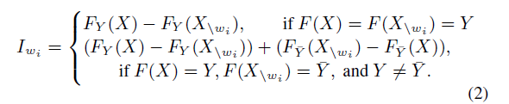
TEXTFOOLER (1. Word Importance Ranking )
(가정)
일반적으로 오직 몇 개의 단어만 실제 분류 결과에 큰 영향을 미침
→ 중요한 단어 위주로 변경
해당 단어(w_{i})가 없을 때 문장의 의미가 바뀌는지 확인
X = { w₁, w₂ , ... ,w_{n} }
X_{\wi} = X _{\{wi}} = {w₁, … , w_{i-1} , w_{i+1} , ... ,w_{n}}
Importance score of w_{i}
Notes:
F(X_{adv}) $≠$ F(X), and Sim(X_{adv}, X) $≥ ε$

Slide 9
TEXTFOOLER (2. Word Transformer)
CANDIDATES ( 동의어 추출 )
CANDIDATES is initiated with N closest synonyms according to the cosine similarity between w_{i} and every other word in the vocabulary.
POS Checking ( 품사 유지 )
assure that the grammar of the text is mostly maintained

Slide 10

TEXTFOOLER (2. Word Transformer)
Semantic Similarity Checking
X_{adv} 와 X 의 유사도 계산
c $ϵ$ CANDIDATES
X_{adv} = {w_{1,} … , w_{i-1} , c, w_{i+1 ,} ... ,w _{n}}

Slide 11
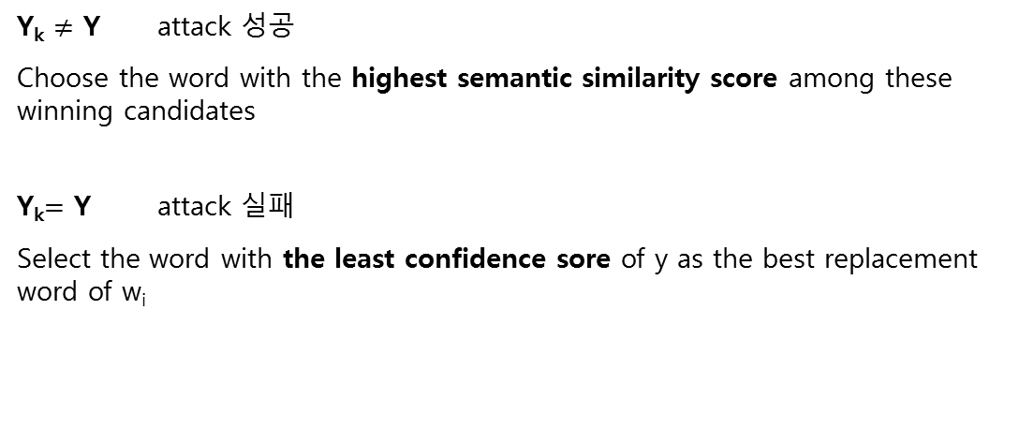
TEXTFOOLER (2. Word Transformer)
Y_{k} $≠$ Y attack 성공
Choose the word with the highest semantic similarity score among these winning candidates
Y_{k}$=$ Y attack 실패
Select the word with the least confidence sore of y as the best replacement word of w_{i}

Slide 12
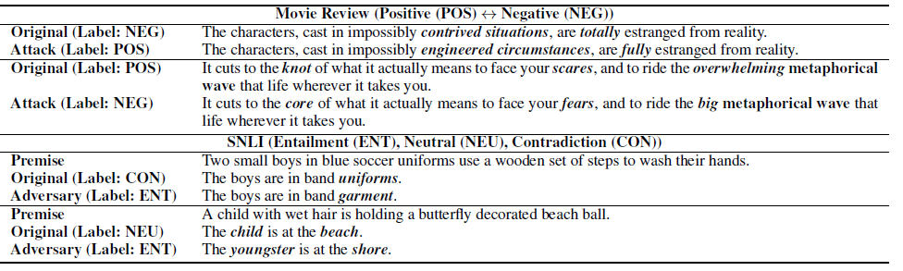
TEXTFOOLER

Slide 13
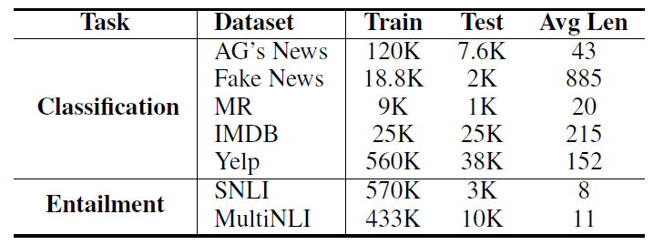
Experiments
Datasets
Target Model Classification : WordCNN / WordLSTM / BERT
Entailment : InderSent / ESIM / BERT
Evaluation
1. Automatic Evaluation : Model Accuracy
USE : Semantic Similarity ( Sentence Embedding )
2. Human Evaluation : Grammaticality / Classification Consistency / Semantic Similarity
Notes:
output class : 4 / 2 / 2 / 2 / 2 ///// 3 / 3

Slide 14
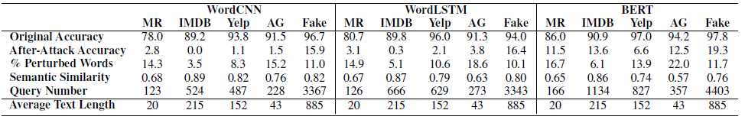
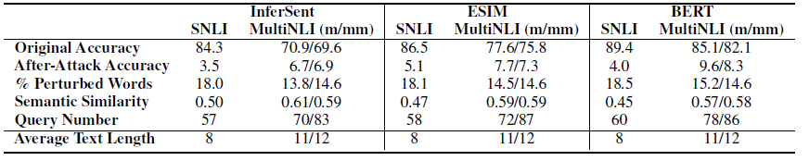
Experiments
Notes:
output class : 4 / 2 / 2 / 2 / 2 ///// 3 / 3

Slide 15
TEXTFOOLER 한계
Synonym Replacement
Token-level similarity 에만 의존
“The restaurant service was poor”.
broke : inappropriate
terrible : context-aware

Slide 16
BAE

Slide 17
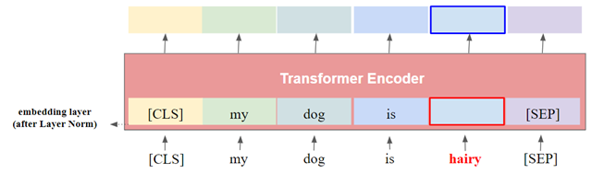
BERT-MLM(Masked Language Model)
input에서 무작위 하게 몇 개의 token을 mask
주변 단어의 context만을 보고 mask된 단어를 예측

Slide 18
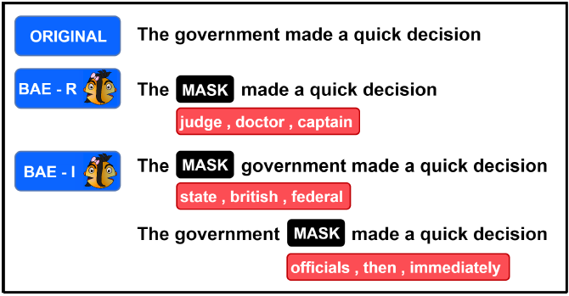
BAE
BAE-R Replace word w_{i}
BAE-I Insert a word to the left or right of w_{i}
BAE-R/I Either replace word t or insert a word to the left or right of w_{i}
BAE-R+I First replace word w_{i}, then insert a word to the left or right of w_{i}
Notes:
generating adversarial examples using contextual perturbations from a BERT masked language model.
BAE replaces and inserts tokens in the original text by masking a portion of the text and leveraging the BERT-MLM to generate alternatives for the masked tokens

Slide 19
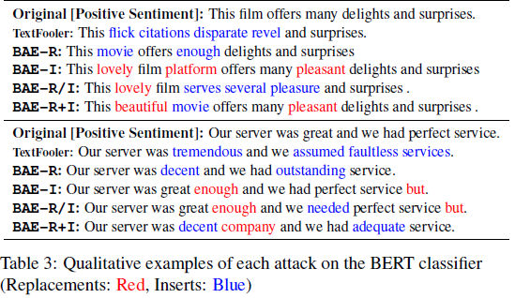
BAE
주요 단어 추출
단어 w_{i} 가 문장의 classification의 영향을 주는 정도 계산
(가정) 중요한 단어를 직접 바꾸거나, 주변에 다른 단어를 넣으면 classification이 바뀔 가능성이 높음
Insert / Replace
중요도가 높은 단어부터 Masking
BAE-I ( Insert ) 의 경우 해당 단어 근처에 mask 삽입
BERT_MLM을 이용하여 mask에 들어갈 단어 k개 예측
I_{i} 0.1 0.8 0.3 0.5 0.7 0.1 0.4
?
movie
book
class
?
lovely
factual

Slide 20
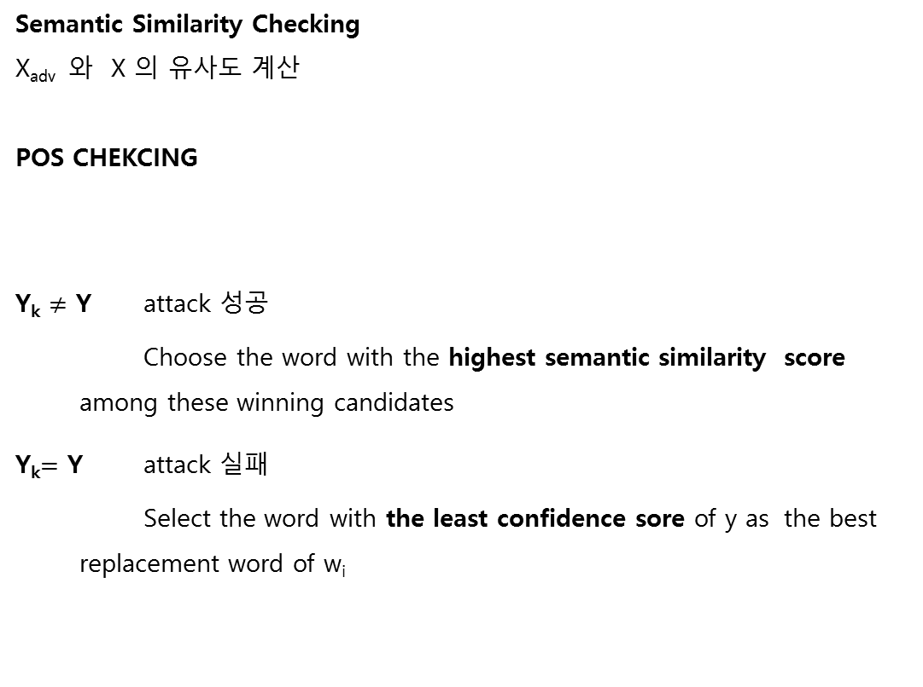
BAE
Semantic Similarity Checking
X_{adv} 와 X 의 유사도 계산
POS CHEKCING
Y_{k} $≠$ Y attack 성공
Choose the word with the highest semantic similarity score among these winning candidates
Y_{k}$=$ Y attack 실패
Select the word with the least confidence sore of y as the best replacement word of w_{i}

